Slide 1
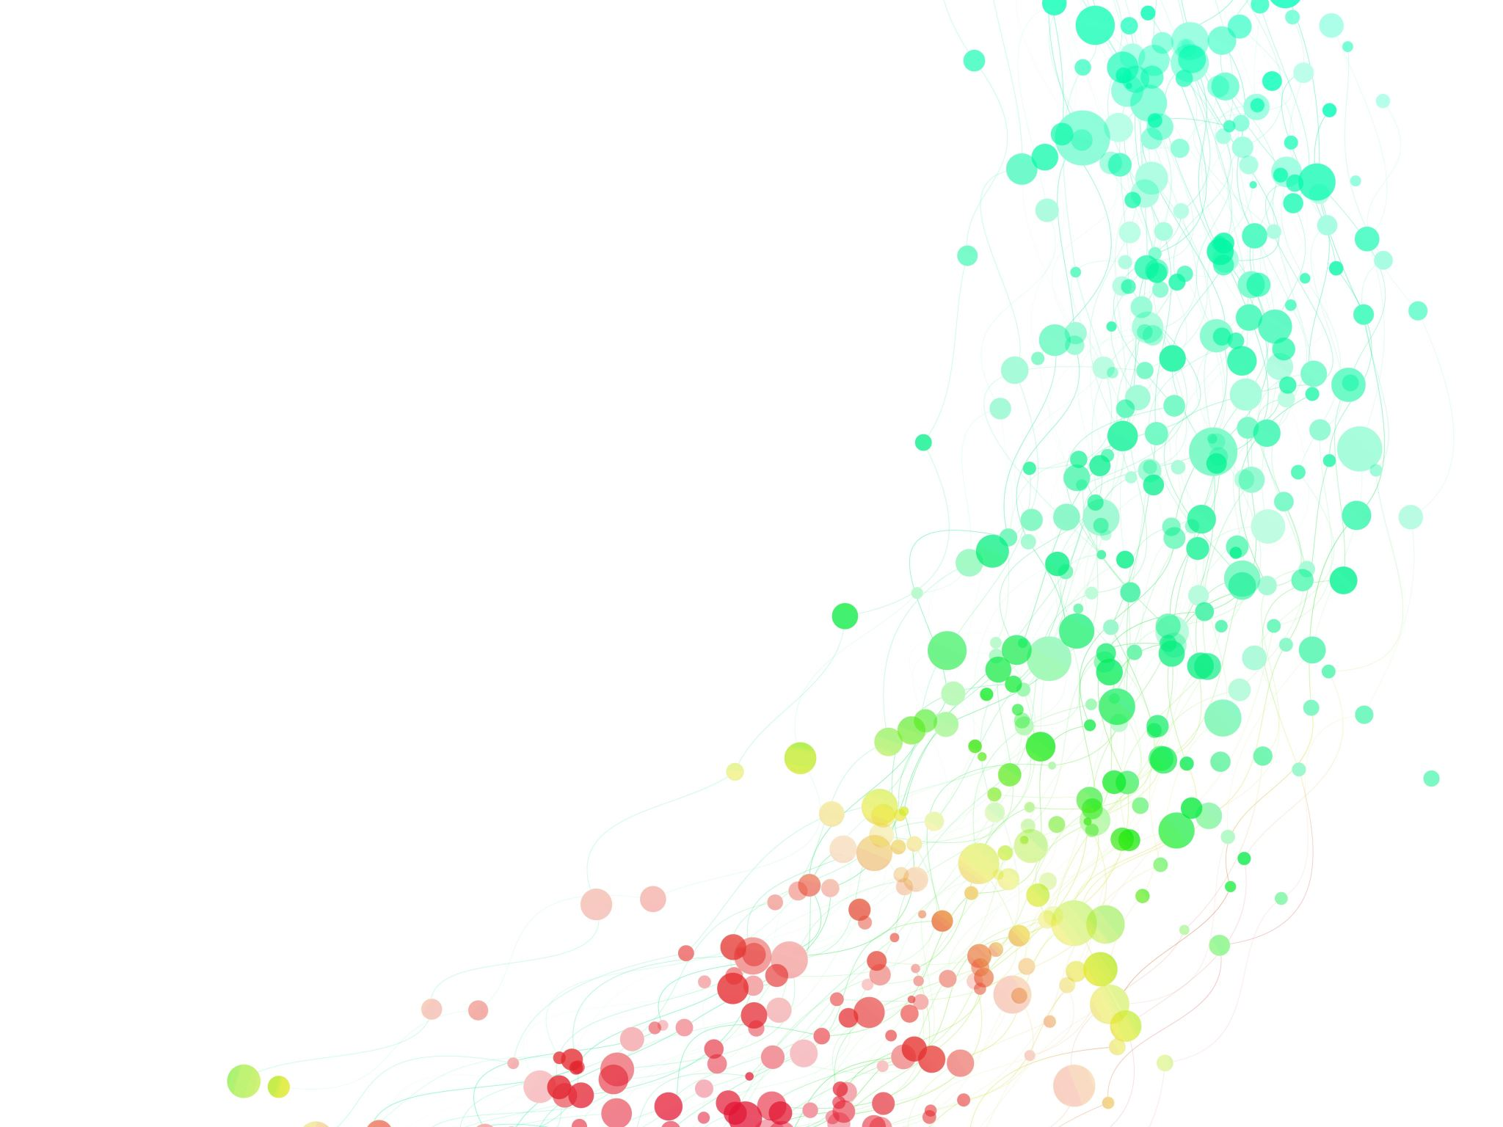
Heart Failure Patient Risk of Death Profile
Capstone II: Unsupervised Learning
By: Rakim Reid
5/12/2023

Slide 2

About Heart Failure
The purpose of this project is to create groupings of heart failure patients of sudden death. This will enable the determination those most at-risk of sudden death and, if desired, predict which group patients belong.

Slide 3
What is heart failure?
Well, according to the Mayo Clinic:
“Heart failure occurs when the heart muscle doesn't pump blood as well as it should. When this happens, blood often backs up and fluid can build up in the lungs, causing shortness of breath.
Certain heart conditions gradually leave the heart too weak or stiff to fill and pump blood properly. These conditions include narrowed arteries in the heart and high blood pressure.

Slide 4

Data Source
Tanvir Ahmad, Assia Munir, Sajjad Haider Bhatti, Muhammad Aftab, and Muhammad Ali Raza: "Survival analysis of heart failure patients: a case study". PLoS ONE 12(7), 0181001 (2017).
Features used were:
Age, creatinine phosphokinase, platelets, serumcreatinine, and serum sodium.

Slide 5
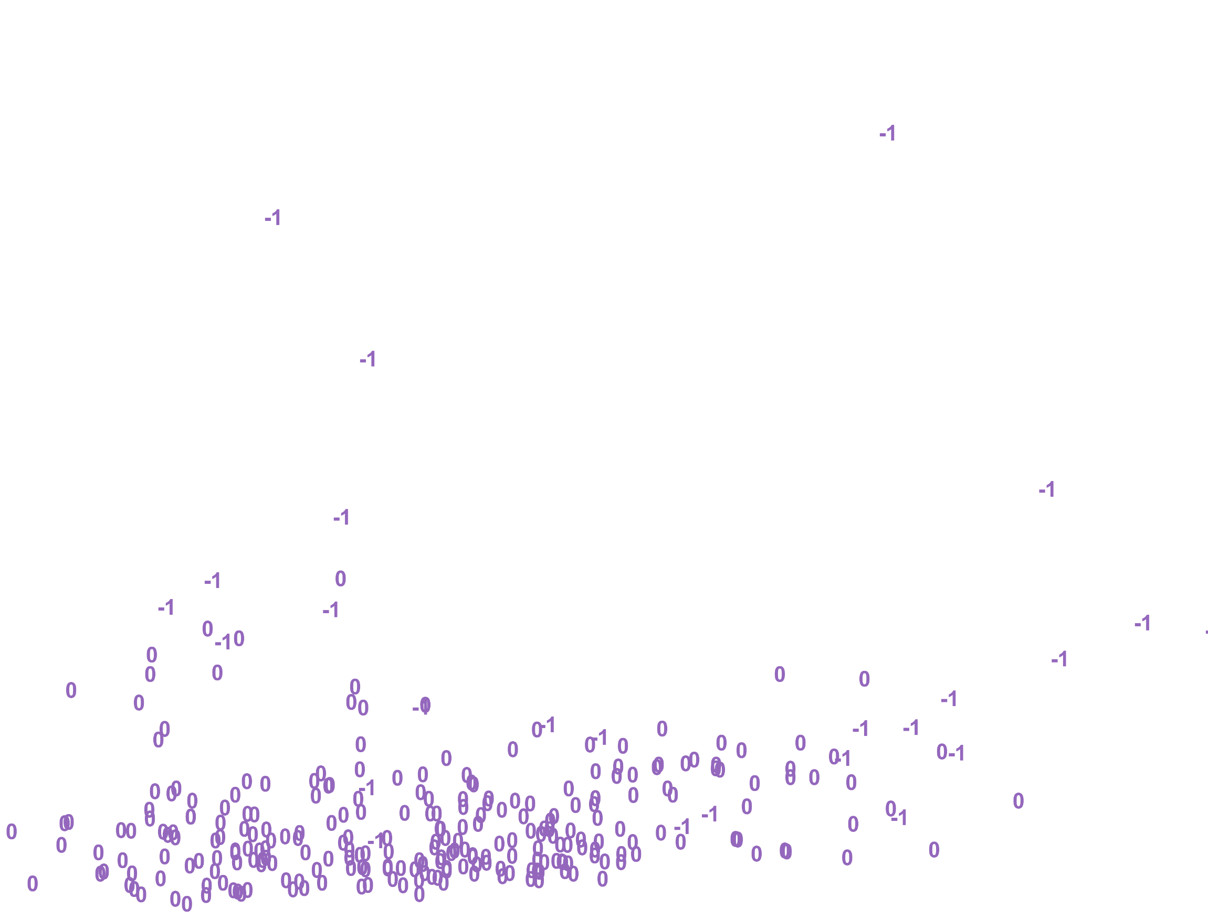
Chosen Model
DBSCAN with PCA
2 clusters
Minimal misclassifications

Slide 6
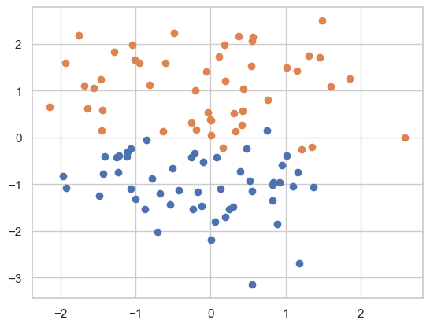
Possible Alternate Model
Spectral Clustering
2 clusters
No to minimal misclassifications

Slide 7

1st Models All Features Used
Gaussian Mixture Model (GMM) w/ PCA results¶
Adjusted Rand Index of the GMM solution: 0.11506460033654581 The silhouette score of the GMM solution: 0.11758319523287136
K Means w/ PCA results
Adjusted Rand Index of the KMeans solution: 0.06821745068708354 The silhouette score of the KMeans solution: 0.13333462466066678
DBSCAN w/ PCA Results
Adjusted Rand Index of the DBSCAN solution: 0.022224065328002855 The silhouette score of the DBSCAN solution: -0.16099376287734668
TSNE Results
This model was a squiggly line, almost linear. I did not think this best reflected the type of data analyzed -- especially for clustering. I chose PCA because it did a better job producing clusters.

Slide 8
Final Models Several Features Used
DBSCAN w/ PCA Results
The silhouette score of the DBSCAN solution with Euclidean: 0.4572246497012825.
Adjusted Rand Index of the DBSCAN solution with Euclidean: 0.003593655067798663.
The silhouette score of the DBSCAN solution with Chebyshev distance: 0.47315988515382557
K-Means w/ PCA Results¶
Adjusted Rand Index of the KMeans solution: 0.004175926402351372 The silhouette score of the KMeans solution: 0.23125622798405496
GMM w/ PCA Results
Adjusted Rand Index of the GMM solution: 0.020601096841243217 The silhouette score of the GMM solution: 0.22824263534337996

Slide 9
Model Limitations
Used non-categorical, continuous features only.
A prediction model might perform better.
Other algorithms might do a better job clustering
Dataset may not include other unknown or lesser known causes of sudden death from heart failure in patients.

Slide 10
Practical Uses for Model
The primary use for this model is to determine – based on the features selected – is determining if a patient is at risk of sudden death.
In short, this work may identify individuals for treatment.

Slide 11
The DBSCAN w/ PCA, two clusters, and Euclidean distance performed the best – for the most appropriate model. There might be merit to pursuing spectral clustering. BIRCH clustering misclassified one point while spectral clustering properly classified all the points. This capstone illustrates the viability of using clustering methods to segment patients who may be at risk of heart failure. Other data transformations like UMAP may be useful to improve results.
Conclusion

